Slide 1

Generic Library System
Software engineering Project (cs303)

Slide 2
Team Members :
Jitendra puppala 191CS237
Keerthana patil 191CS231
Mahadev Hatti 191CS133
Harshita 191CS120
Vamshi krishna M 191CS261
Course Name : Software Engineering Lab(SE303)
Course instructor : Dr.Annappa

Slide 3
About the Project
As the project name suggests automation in which the human input can be minimised and makes the work of librarian a lot easier and experience of user a lot simpler.
This has some new features like requesting book from other students, buying books from catalogue, if available for sale and reviewing and rating books and feedback of experience etc.
We can also track the history of users (books user has taken before and now).
We can also track history of books (users who took the book previously and now).
It makes library user and librarian work very simpler and easier.

Slide 4
Project scope
The purpose of the proposed system is to provide uncomplicated, trouble-free environment to the respective users.
It reduces the manual work being done in the current system.
Make functionalities more error-free and explicit.
Make information more precise and reliable.

Slide 5



Software specifications
Backend :
Django, PostgreSQL
Frontend :
HTML, CSS , JS

Slide 6
Client Software Requirements:
The Software application can run in any of the following web browsers running on the specified operating systems:
Microsoft Edge (latest publicly-released version) running on Windows 10, Window 8.1, Windows 8, Windows 7
Mozilla Firefox (latest publicly-released version) running on Windows 10, Windows 8.1, Windows 8, or Windows 7, Linux debian distros
Apple Safari (latest publicly-released version) running on the two latest publicly-release Mac OS versions, or Apple iPad

Slide 7
Hardware Specifications
For Laptops/Desktops :
Component | Minimum | Recommended
Processor | 1.9 gigahertz (GHz) x86- or x64-bit dual core processor | 3.3 gigahertz (GHz) or faster 64-bit dual core processor
memory | 2 Gb Ram | 4 gb RAM
display | Super VGA with a resolution of 1024 x 768 | Super VGA with a resolution of 1920 x 1080
For Mobile Devices / Tablets :
OS | Browsers
iOS | iOS11+ with Safari 12+ or chrome 77+
Android | Android 7+ with Chrome 77+, Firefox 80+

Slide 8
Non-functional Requirements
Scalability and reliability is taken care by Django, as it is simple, highly scalable and flexible.
Security of the sensitive data transmission of users is taken care by Django.
We designed the database with high data integrity.
The performance of the application will be good with the optimized queries in PostgreSQL.
Maintainability and Manageability of the application will be good, as we are following the best Software principles.
The portability of the application is high, as we are using one of the most popular framework.

Slide 9
System Design
Admin Functionalities
User functionalities
Generic library
User
Admin
Database

Slide 10
System Architecture
View Layer
Mobile ,
laptops,pc,tablets
Logical Layer
User Management
Book Management
Admin Management
Physical Layer
Database

Slide 11
Project Features
1. Admin
2. User
3. Other Features

Slide 12
Admin
Add books
Confirm registration of user
Can see all user details
Remove/add users
Make others admin
Can see the books taken by user
Can track history of book (Users used)

Slide 13
2. User
Request other user, if he needs a book taken by other user.
Pays fine, if he lost the book or delays renewal of book.
History of books he took.
Can buy a book, if available to sale by another user or by library.
Can give Feedback of experience while taking books
Can mention tasks in to-do-list

Slide 14
3. Other Functionalities
Automated emails to users, reminding for renewal of books..
Lending/Taking books is of 3 categories.
Take book from Library
Take book from other user
Buy book, if available for sale
Automated emails on registration approval/banning/termination

Slide 15
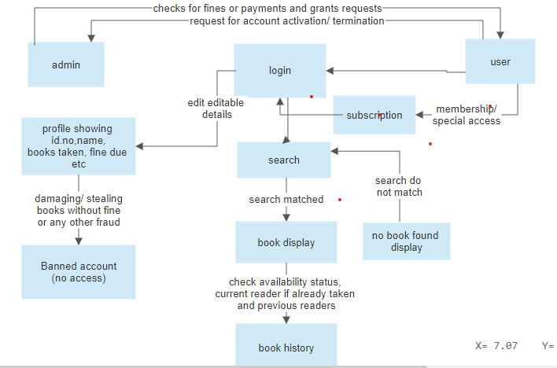
User data flow:

Slide 16
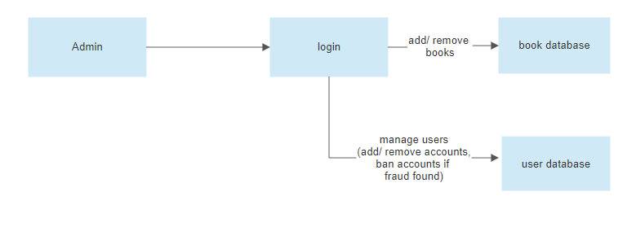
Admin Data Flow:
Link to the diagrams:
https://cloud.smartdraw.com/share.aspx/?pubDocShare=09445A66C8F1EB0A0CFEA83CB3935258EE8

Slide 17
Activity Flow Diagram
https://raw.githubusercontent.com/jithendra1798/SE-Project/main/assets/Dataflow1.png
Whiteboard Presentation

Slide 18
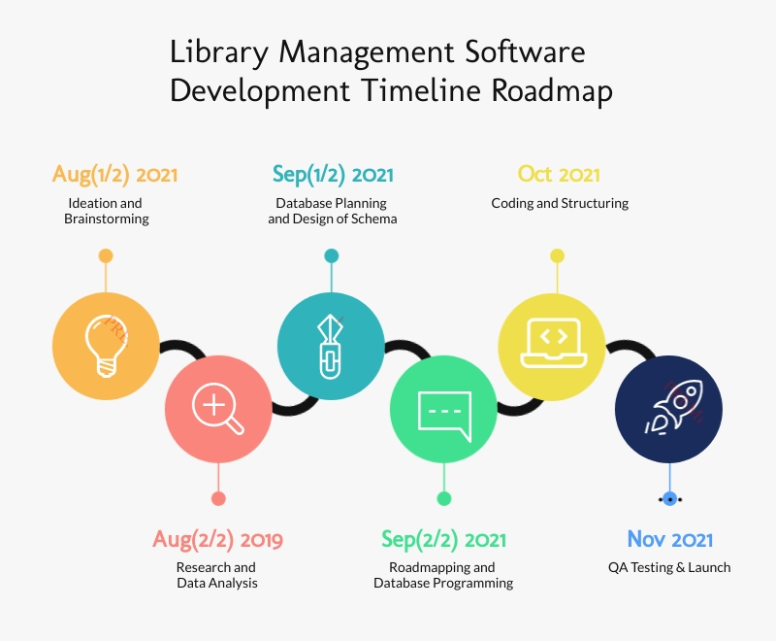
Current Status

